Slide 1
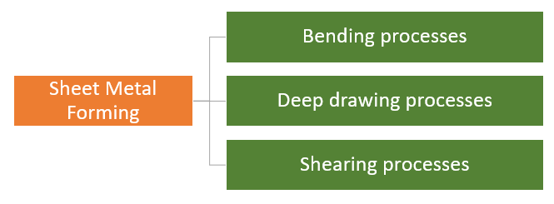
SHEET METAL FORMING

Slide 2
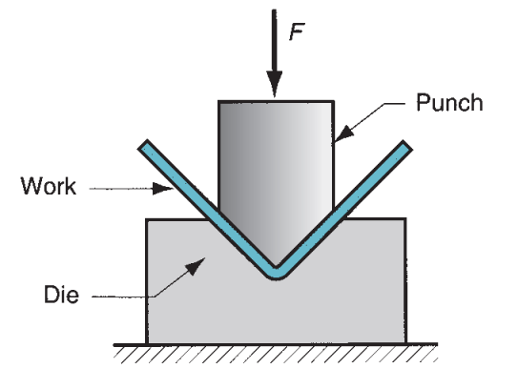
BENDING

Slide 3
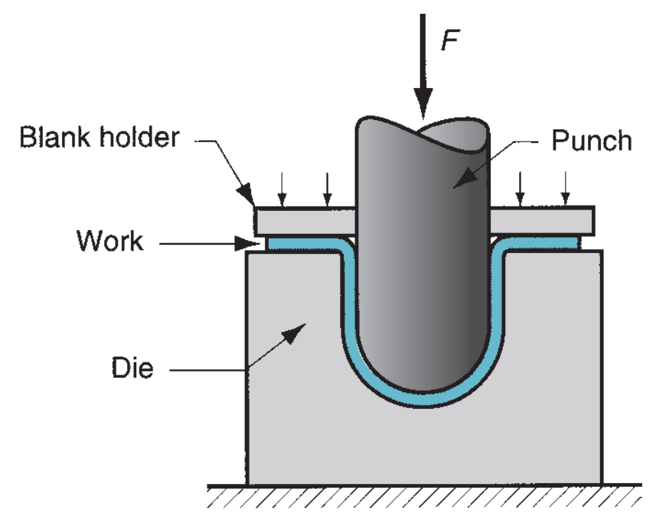
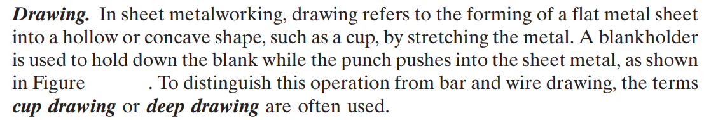
DEEP DRAWING

Slide 4
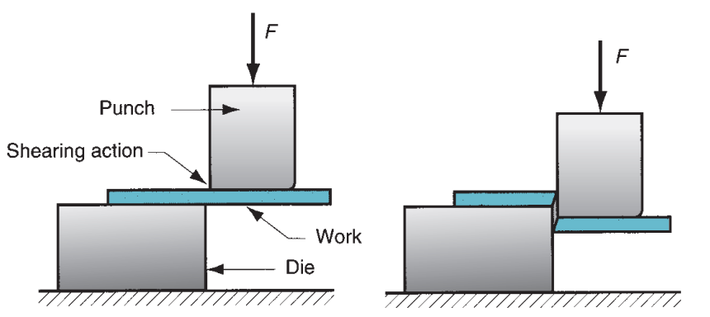
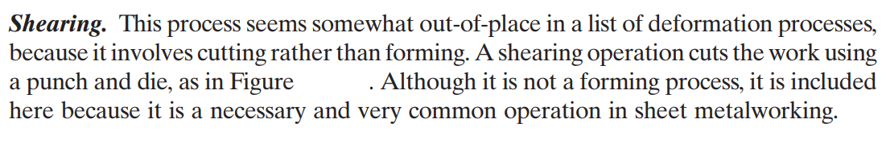
SHEARING

Slide 5
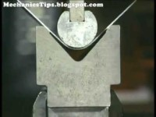
SHEARING and BENDING

Slide 6
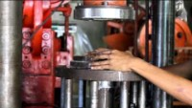
DEEP DRAWING

Slide 7
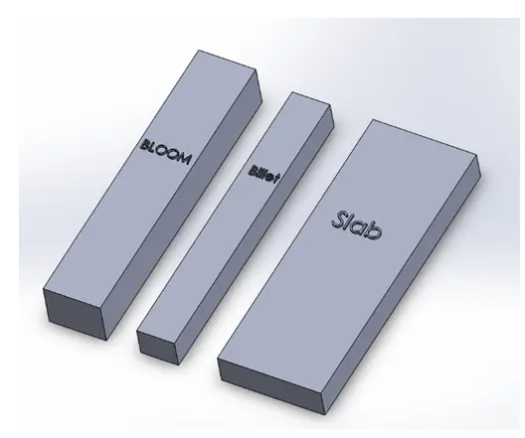
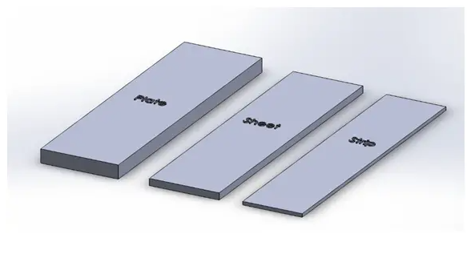
Terminology
Ingot: A metal taken out from the cast with various defects before subjecting for rolling.
Bloom: It is the first rolled product of Ingot, with a Cross-section area of more than 230 cm².
Billet: The product is obtained by further rolling of Bloom, having an area of Cross-section greater than 6 cm².
Slab: It is a hot Rolled Ingot, with a Cross-section area greater than 100 cm² and Width >= 2*thickness.
Plate: It is the Mill product, with thickness more than 6 mm.
Sheet: It is a Mill product, with thickness less than 6 mm, and width greater than 600 mm.
Strip: It is a Mill product with thickness less than 6 mm, and width less than 600 mm.

Slide 8
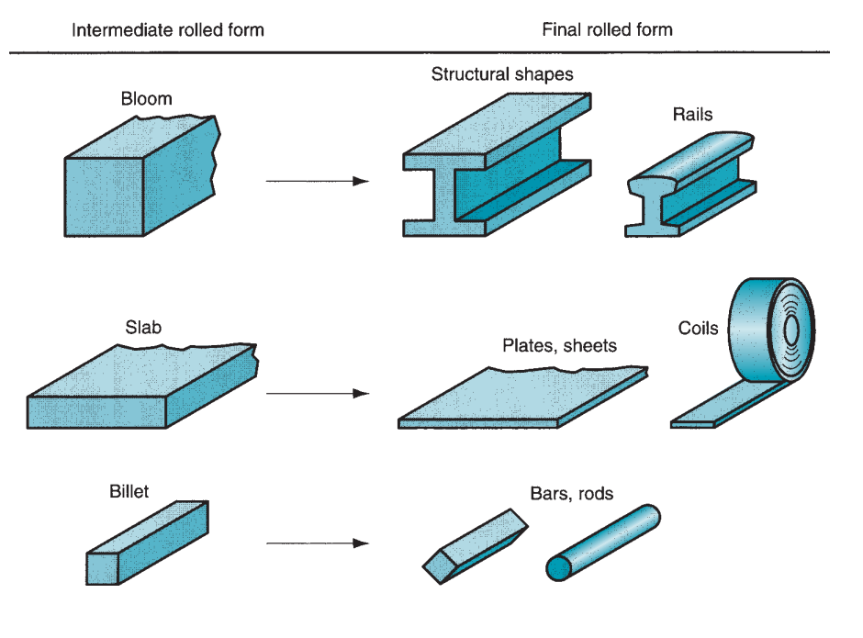

Slide 9
Types of Rolling Mills
Two-High Rolling Mill
Three-High Rolling Mill
Four-High Rolling Mill
Cluster Rolling Mill
Multi-High Rolling Mill
Universal Rolling Mill

Slide 10
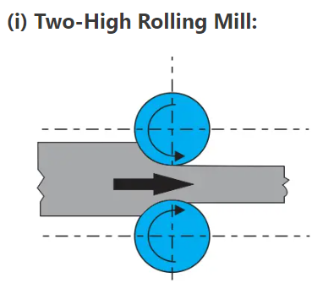
The Metal (Ingot) is passed continuously and approximately 25-30 passes are required to convert Ingot to Bloom.

Slide 11
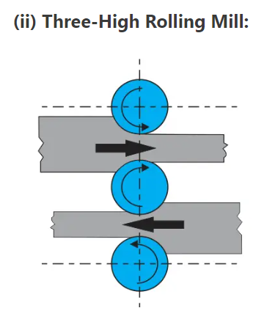
In this type of Rolling mill, the Direction of the drive is not changed after each pass. It is more Productive and easier with respect to the two-High Rolling Mill.

Slide 12
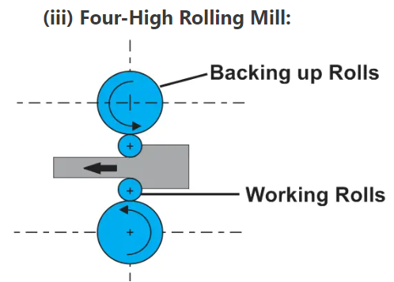
It Consists of two backup rollers and two Working rollers, arranged One over the Other in the same Vertical Plane.
This type of rollers is mainly used in Sheet Rolling.
During the rolling operation the chance of ‘bending of working rollers’ can be seen, as a result, non-uniform compression of sheets may results. this is the reason why backup rollers overcome this issue and also diameter of backup rollers is always greater than the working rollers.

Slide 13
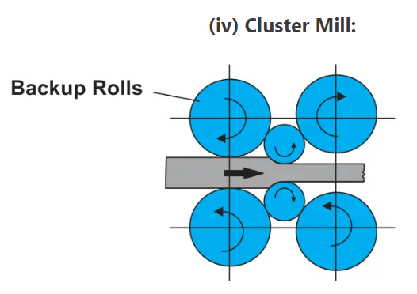
It consists of Two Working rollers and two or more backup rollers.
The number of Backup rollers depend upon the amount of support required for working.
It is mostly used in Cold rolling Operations.

Slide 14
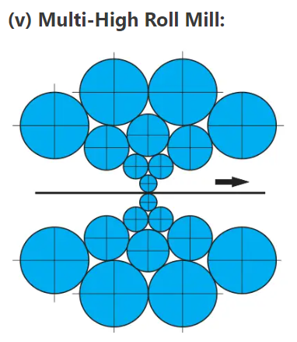
It consists of two small diameters of working rollers and an intermediate row of driving rolls, and a row of Backup rollers.
The arrangement is made in such a way that the whole system achieves exceptional rigidity.
Multi-High Rolling mills are used for making a sheet of minimal thickness.

Slide 15
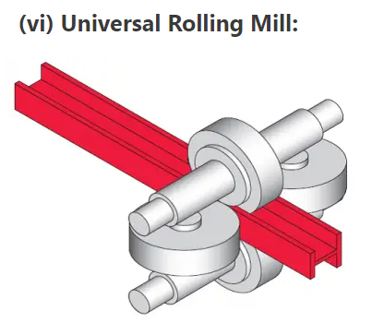
It consists of two vertical rollers and two Horizontal rollers.
The Vertical rollers are arranged between the bearing of horizontal rollers in the vertical plane.
It is widely used to produce blooms from Ingot, and for rolling wide flange H -Section beams.

Slide 16
Types of Rolling
Thread or Gear Rolling
Shape Rolling
Ring Rolling
Tube Piercing
Skew Rolling
Transverse Rolling

Slide 17
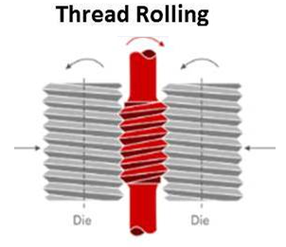
This process is used to cut threads or gear on cylindrical blank.
In this process threaded dies are fitted on cylindrical rollers of rolling machine.
This threaded roller pressed against cylindrical blank and roll against the faces which displace the material and form threads on cylindrical blank.
This process gives high strength and surface finish and used to mass production of screw, bolts etc.

Slide 18
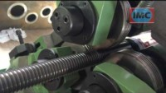
Thread or Gear Rolling

Slide 19
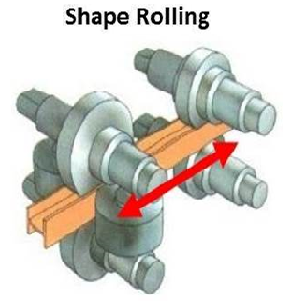
Shape rolling is used to cut various shapes on metal work piece.
It does not involve appreciable change in thickness.
It is used to rolled I section, T section, railroads etc.

Slide 20
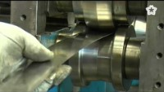
Shape Rolling

Slide 21
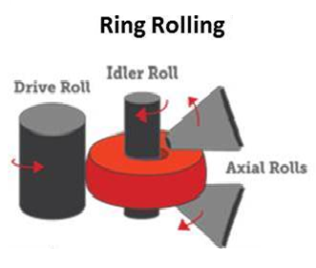
Ring rolling is an another method of rolling which is used to roll rings of large bearings, turbines etc.
The ring rotates due to rotation of roller and the rollers start move closer to each other.
With the help of Idler roll, increase in the diameter of rings can be achieved.
A pair of axial rollers is used to maintain the height of ring.
This process gives high accuracy and material finish.

Slide 22
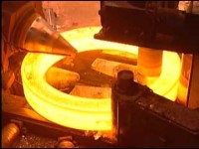
Ring Rolling

Slide 23
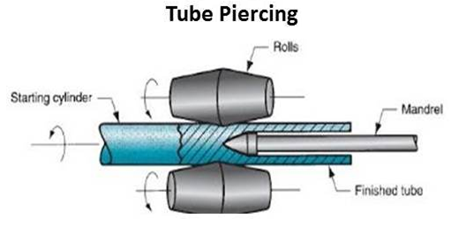
It is another rolling process in which a stationary mandrel is used at the center of tube.
The cavity is formed due to the impact of compressive stress by mandrel.
In this process two opposite rolls are rotate in opposite direction which compresses the tube and feed it against mandrel which create hollow cavity in it.
This process is used to making seamless hollow tubes of thick wall.

Slide 24

Tube Piercing

Slide 25
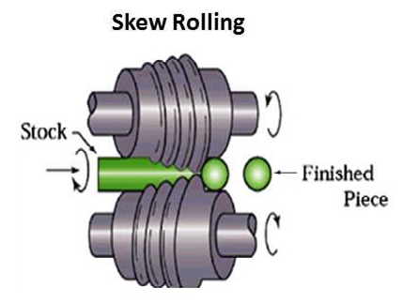
Skew rolling is used to make balls of ball bearing.
In this process round bar or wire is fed directly into special designed rollers which continuously form spherical balls by rolling action.
This process is used for mass production of small size spherical balls.

Slide 26
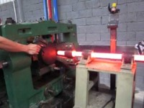
Skew Rolling

Slide 27
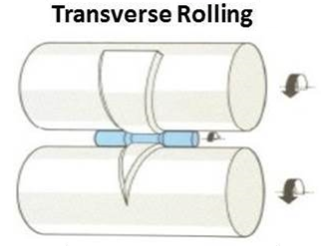
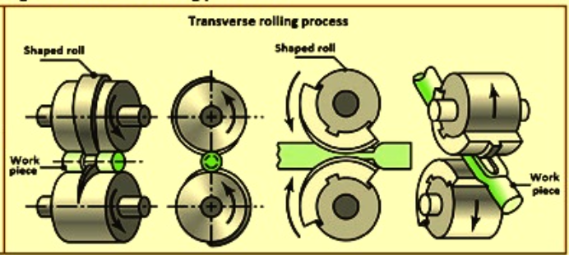
Transverse rolling is another type of rolling which is used to make tapper shaft, leaf springs etc. in this process both rollers are rotated in same direction and the bar is fed transversely.
The rolls are fitted with special kind of tapped section which used to form tapped cavity of cylindrical work piece.
Also called cross rolling, which is used to produce table knives, leaf springs, tapered shafts, and hand tools.

Slide 28

Transverse Rolling

Slide 29
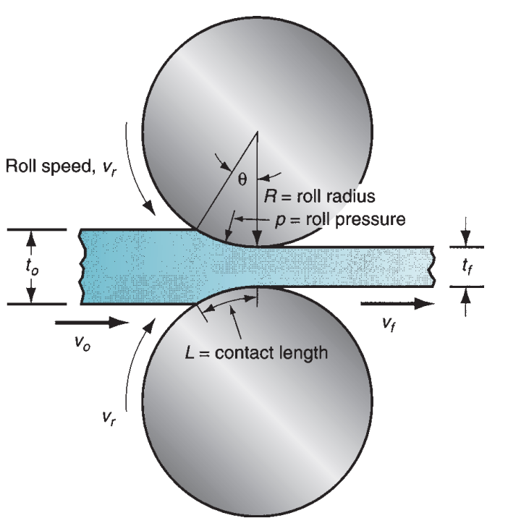

Slide 30
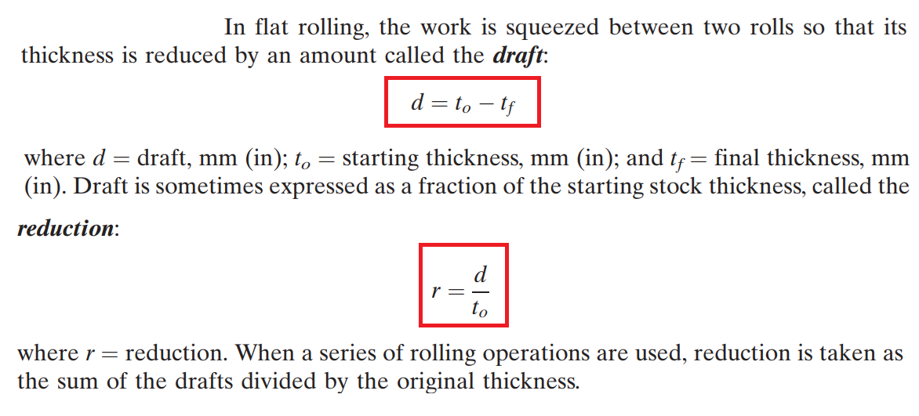

Slide 31
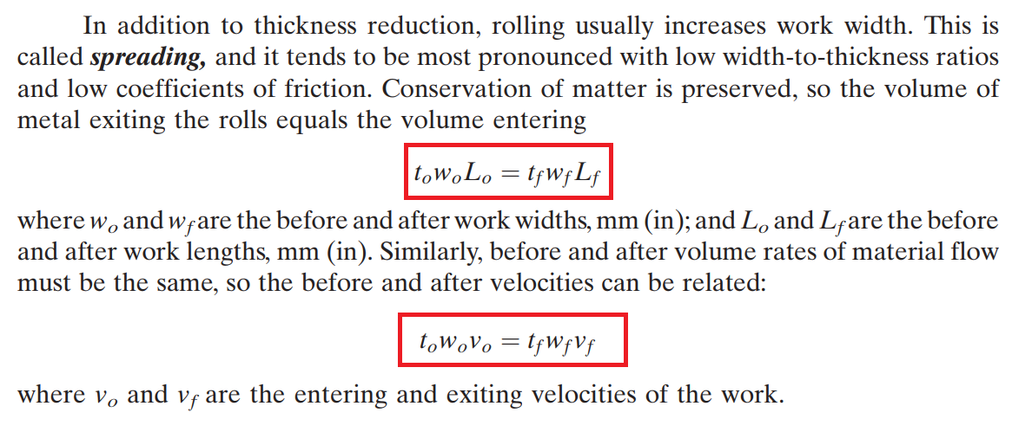

Slide 32
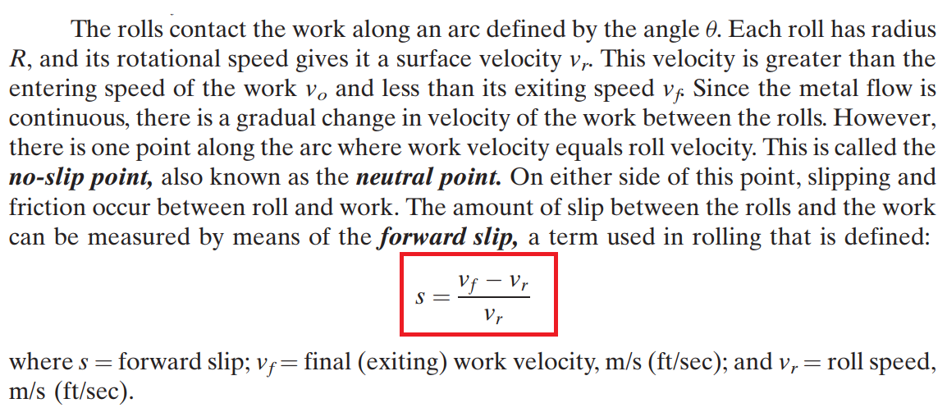

Slide 33
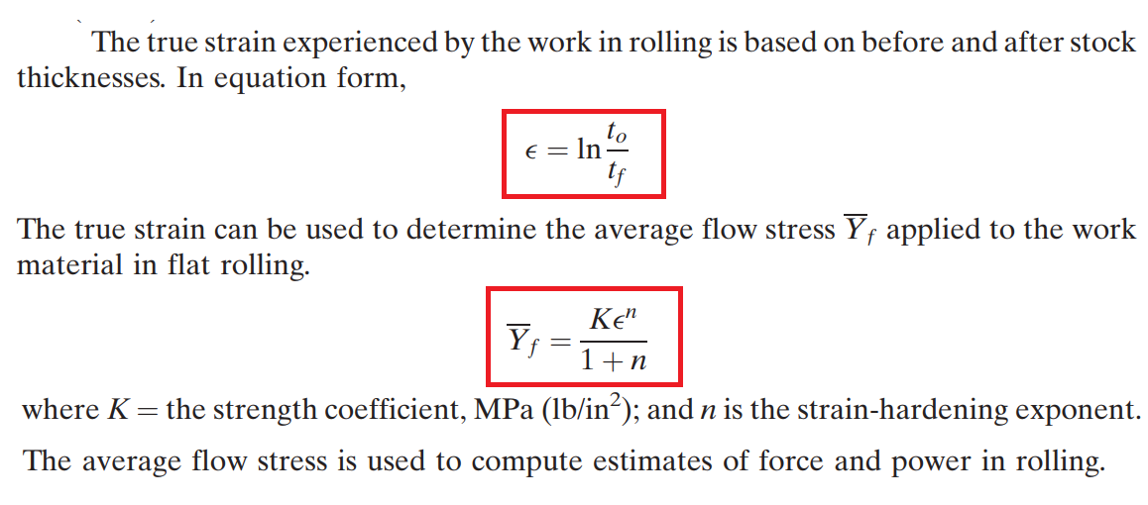

Slide 34
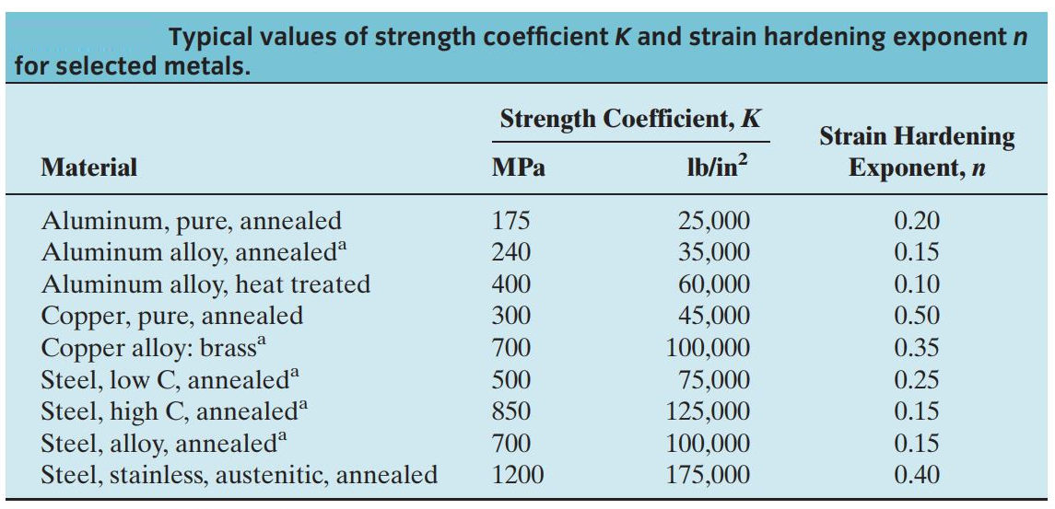

Slide 35
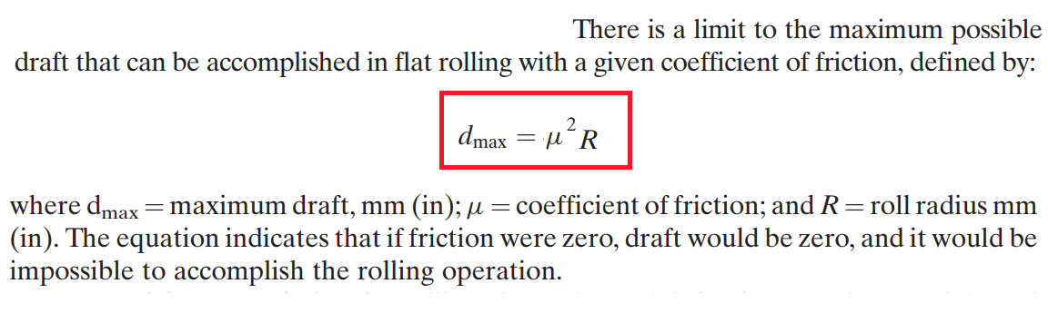
Coefficient of friction in rolling depends on lubrication, work material, and working temperature. In cold rolling, the value is around 0.1; in warm working, a typical value is around 0.2; and in hot rolling is around 0.4. Hot rolling is often characterized by a condition called sticking, in which the hot work surface adheres to the rolls over the contact arc. This condition often occurs in the rolling of steels and high-temperature alloys. When sticking occurs, the coefficient of friction can be as high as 0.7.

Slide 36
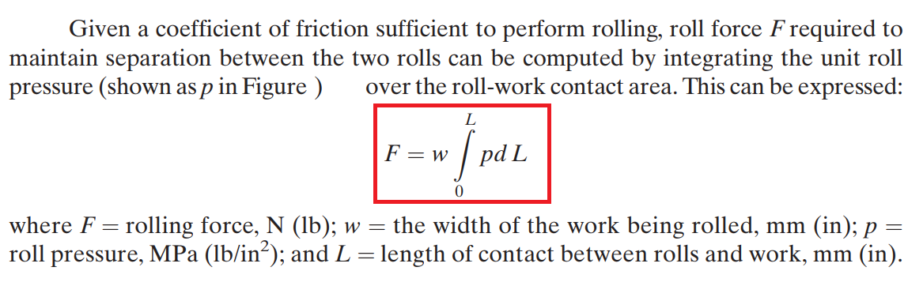
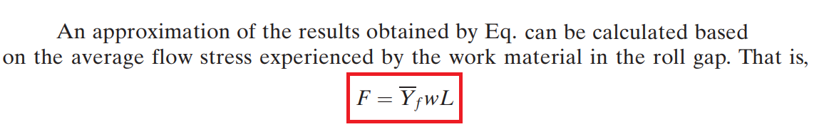

Slide 37
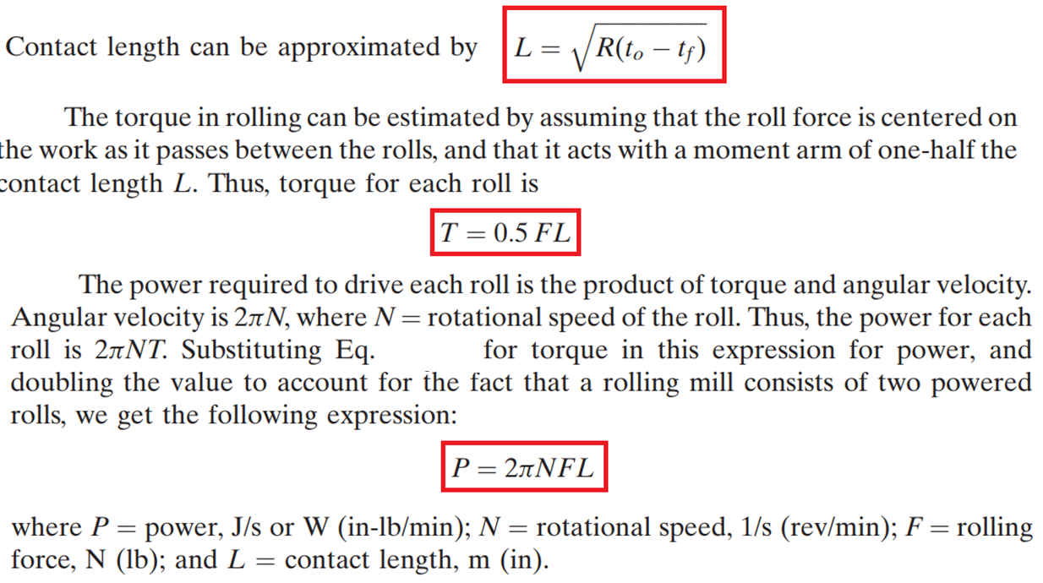

Slide 38
Problem 1
A 300-mm-wide strip 25-mm thick is fed through a rolling mill with two powered rolls each of radius 250 mm. The work thickness is to be reduced to 22 mm in one pass at a roll speed of 50 rev/min. The work material has a flow curve defined by K = 275 MPa and n = 0.15, and the coefficient of friction between the rolls and the work is assumed to be 0.12. Determine if the friction is sufficient to permit the rolling operation to be accomplished. If so, calculate the roll force for each roll, torque the roll, and horsepower the to drive the rolls.

Slide 39
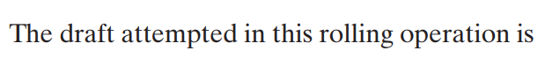
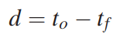
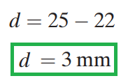
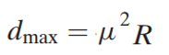
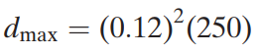
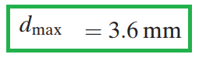

Slide 40
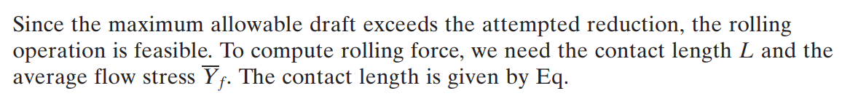
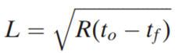
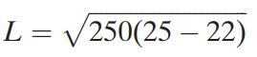
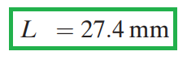
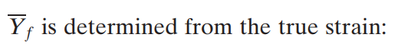

Slide 41
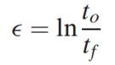






Slide 42








Slide 43








Slide 44


Slide 45


